Slide 1
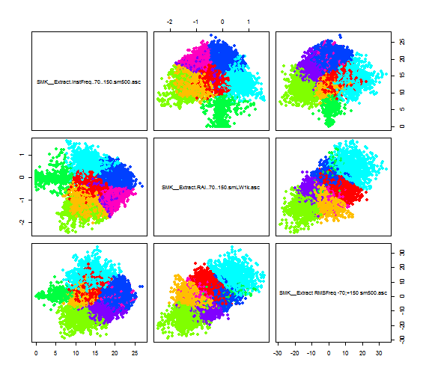
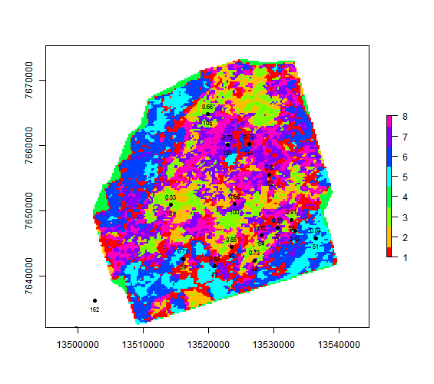
K-means clustering

Slide 2
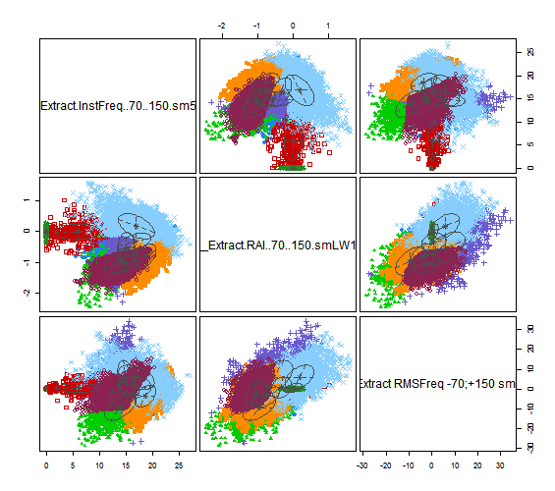
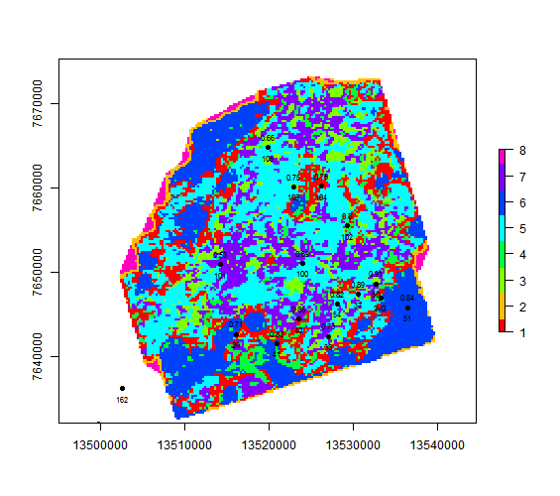
GMM clustering

Slide 3
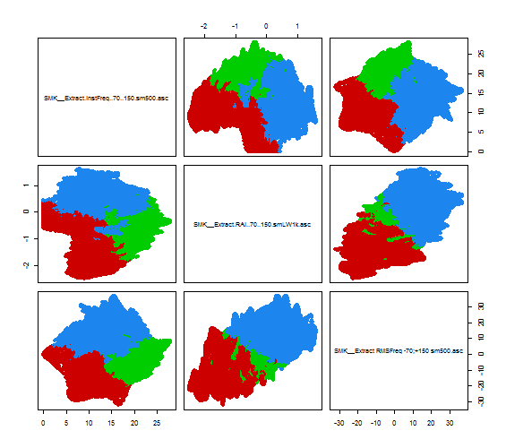
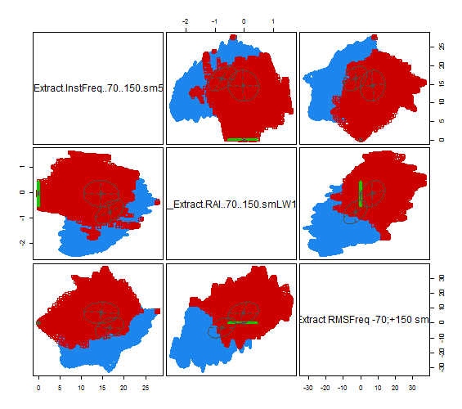
Key difference
K-Means:
fuzzy and sometimes illogical splitting of the classes especially when number of classes is low.
GMM K-Means:
Even statistically small classes with significant distribution difference are successfully separated from background data.

Slide 4
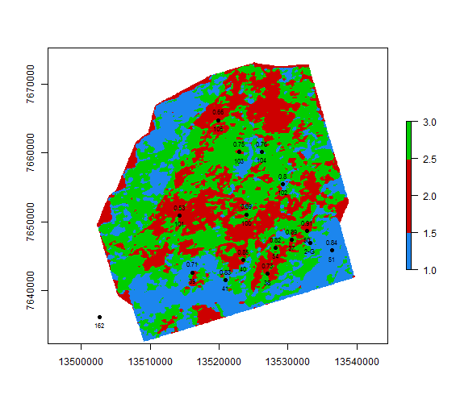
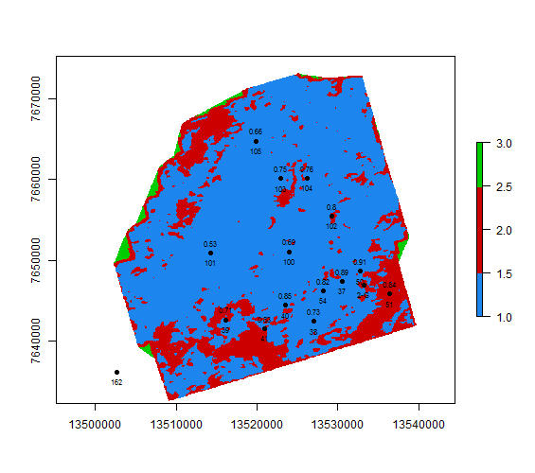
Key difference – Instantaneous attributes with artifacts
K-Means:
Border/edge artifacts were incorporated in the possibly meaningful cluster (red)
GMM K-Means:
Border/edge artifacts are successfully separated from the meaningful data

Slide 5
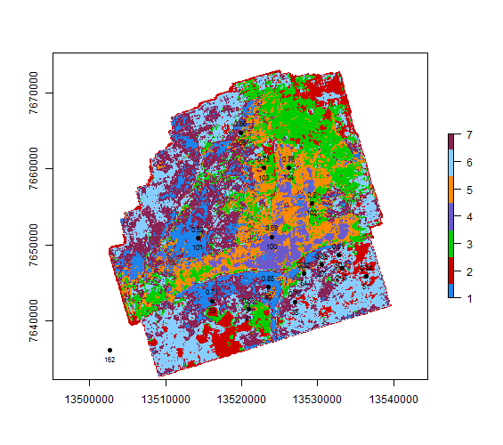
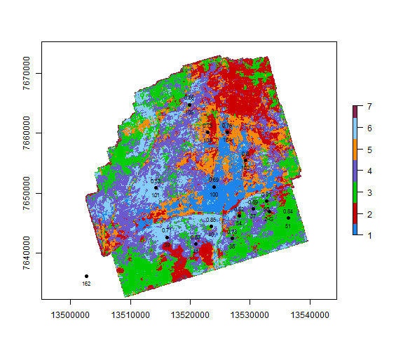
Key difference – spectral decomposition clustering
K-Means 7 classes:
GMM K-Means 7 classes:

Slide 6
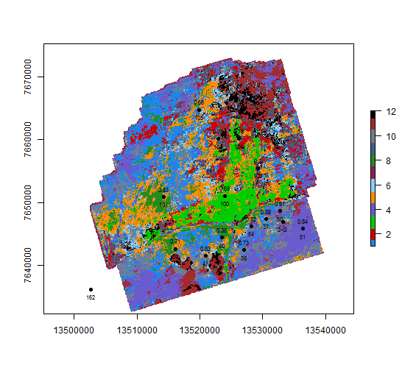
Key difference – spectral decomposition clustering
K-Means:
GMM K-Means (automatic classes):

Slide 7
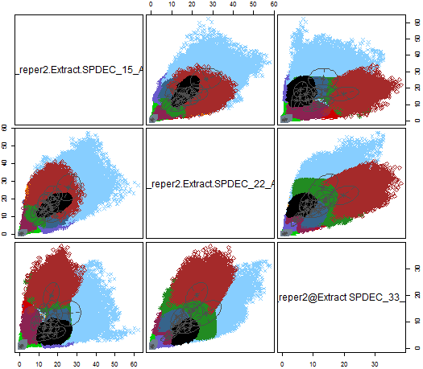
Key difference – spectral decomposition clustering

Slide 8
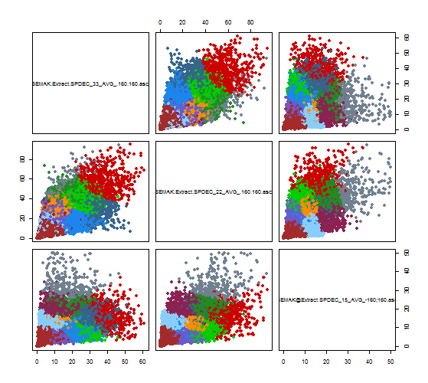
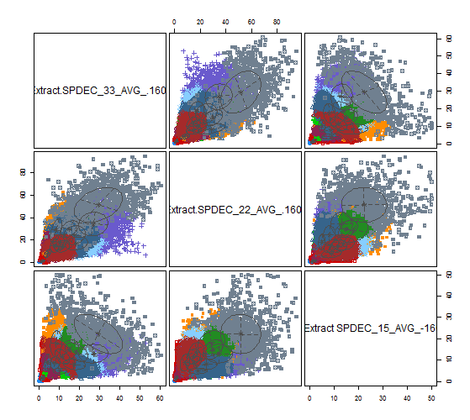
Key difference – spectral decomposition (15-22-33)

Slide 9
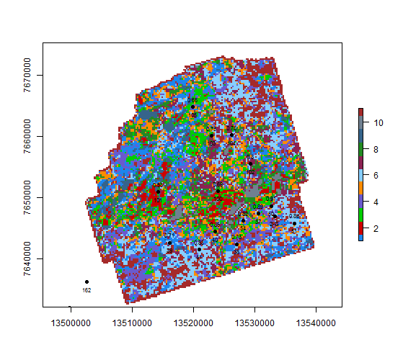
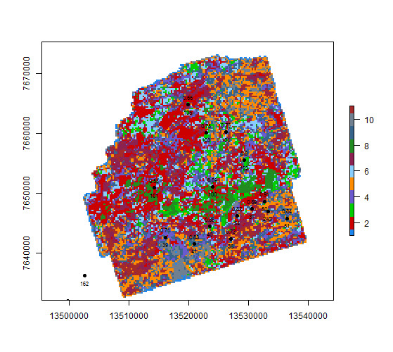
Key difference – spectral decomposition (15-22-33)

Slide 10
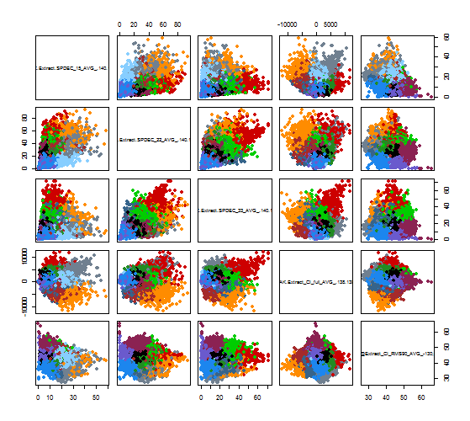
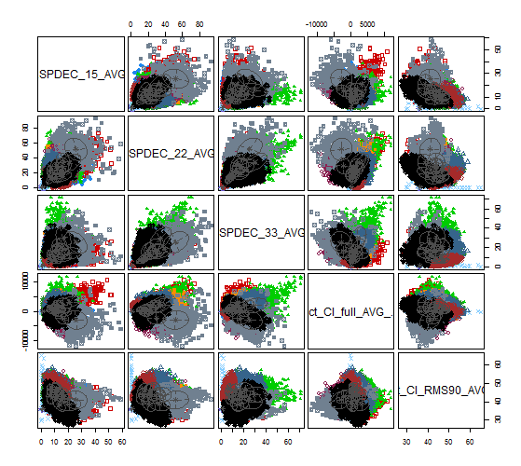
Key difference – PK_r2 + 140ms

Slide 11
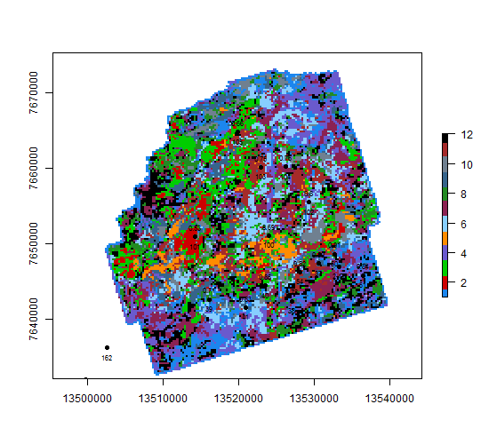
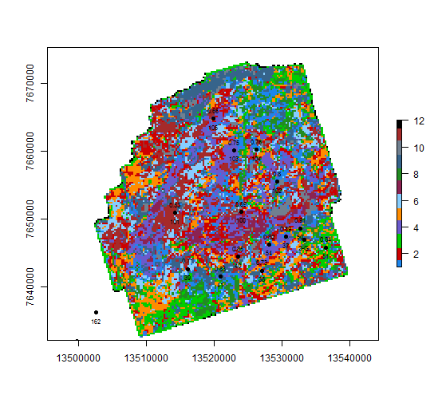
Key difference – PK_r2 + 140ms

Slide 12
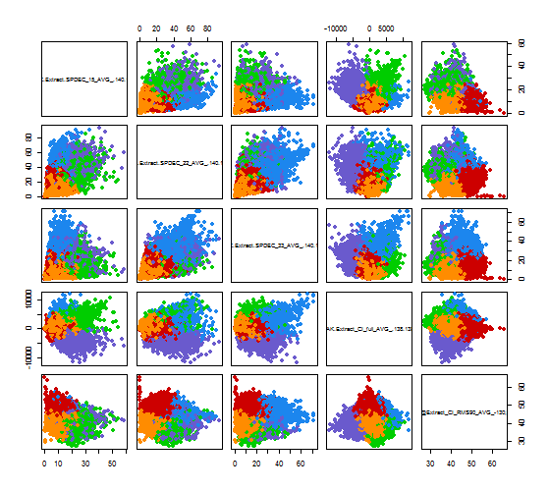
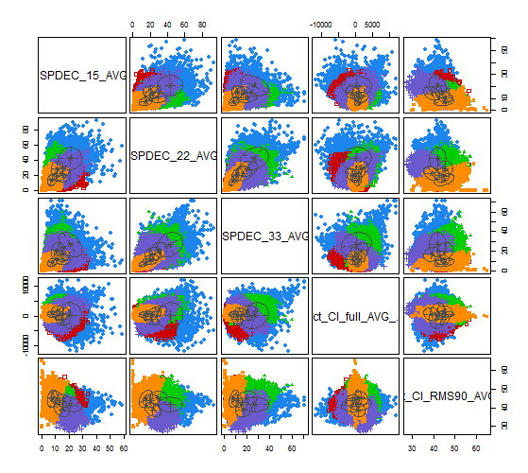
Key difference – PK_r2 + 140ms

Slide 13
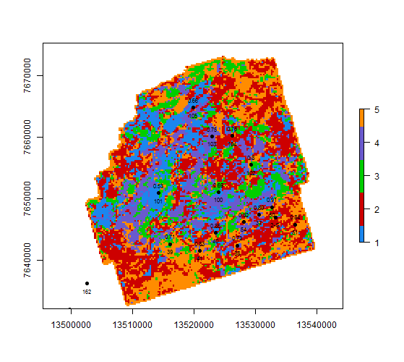
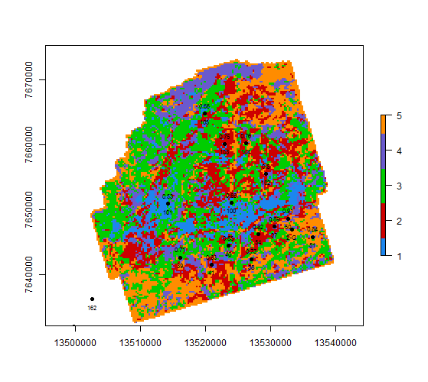
Key difference – PK_r2 + 140ms

Slide 14
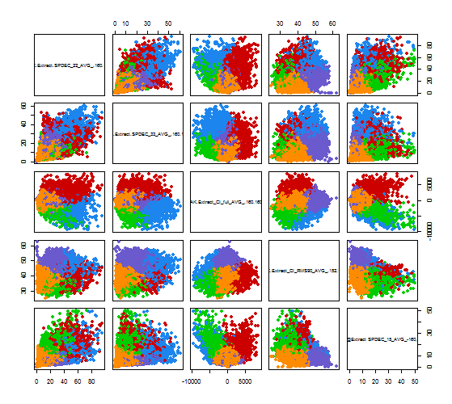
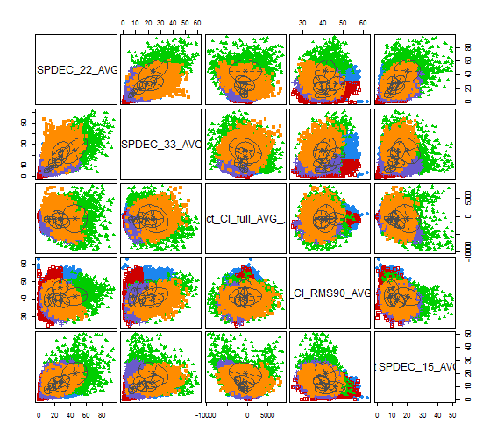
Key difference – PK_r2 + 160ms

Slide 15
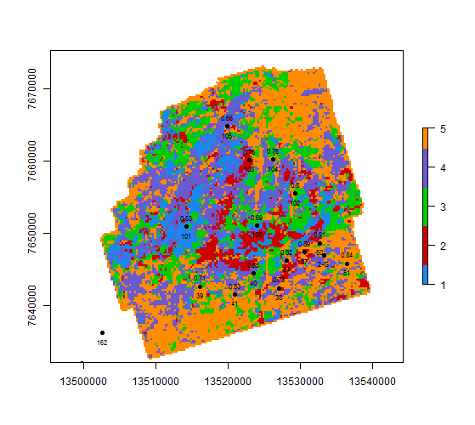
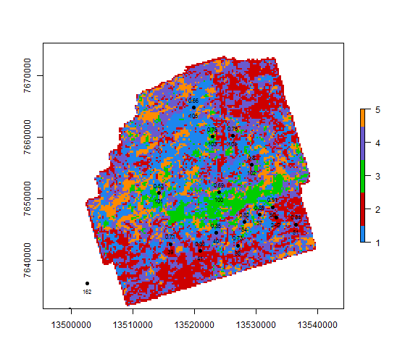
Key difference – PK_r2 + 160ms

Slide 16
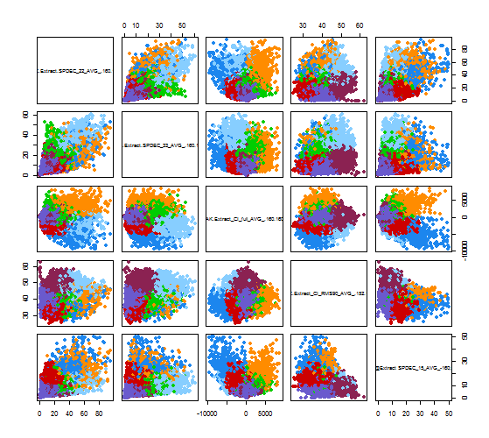
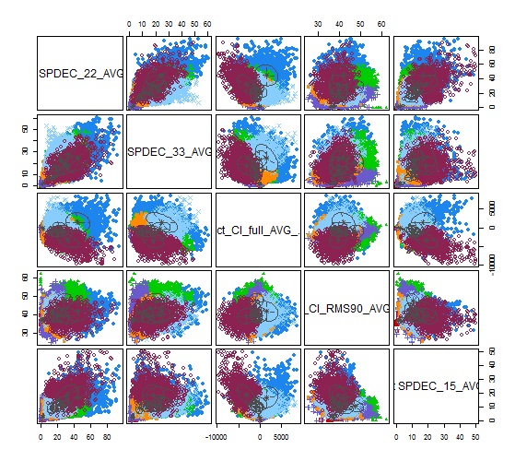
Key difference – PK_r2 + 160ms

Slide 17
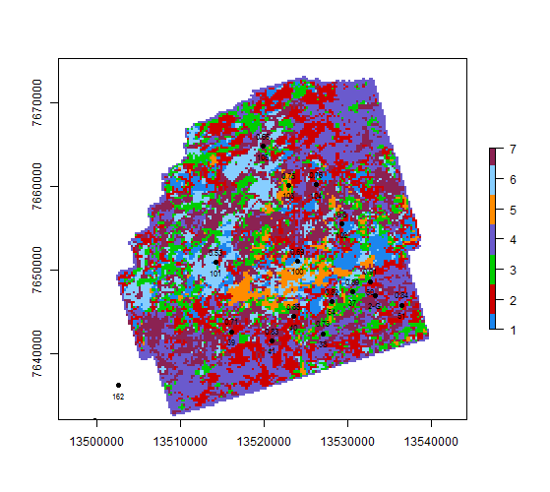
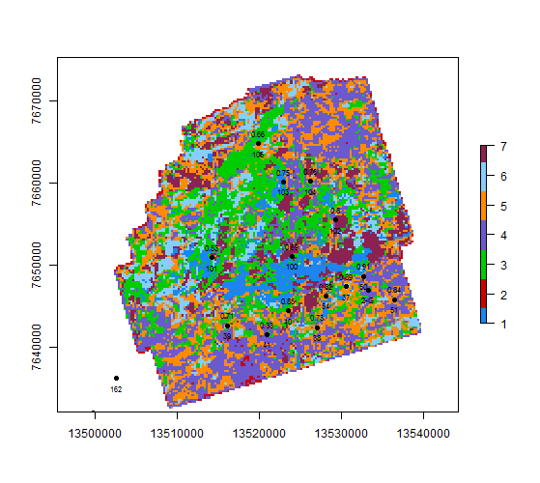
Key difference – PK_r2 + 160ms

Slide 18
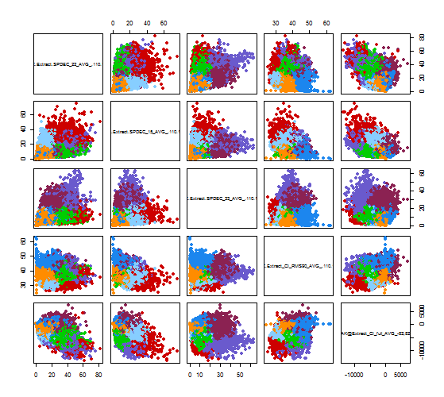
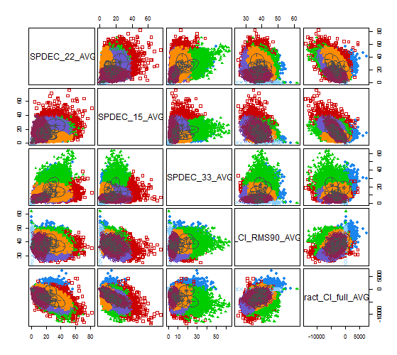
Key difference – PK_r2 + 120ms

Slide 19
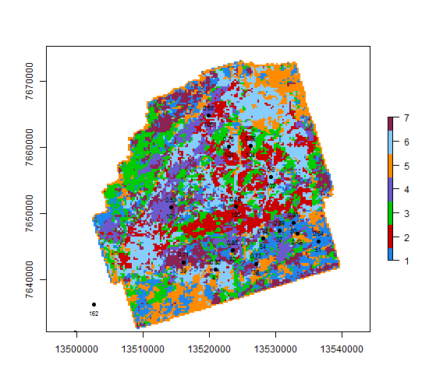
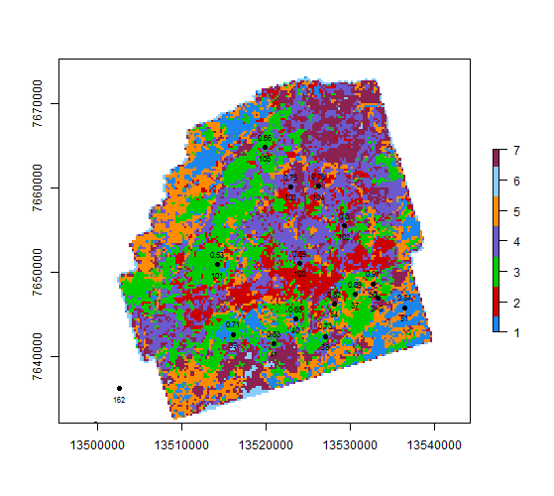
Key difference – PK_r2 + 120ms

Slide 20
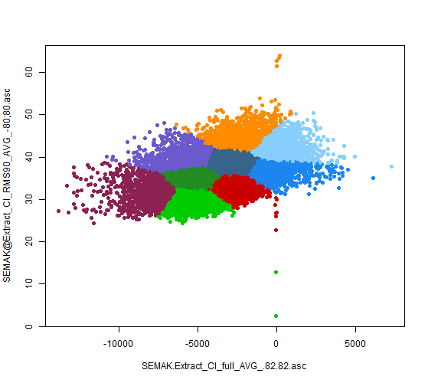
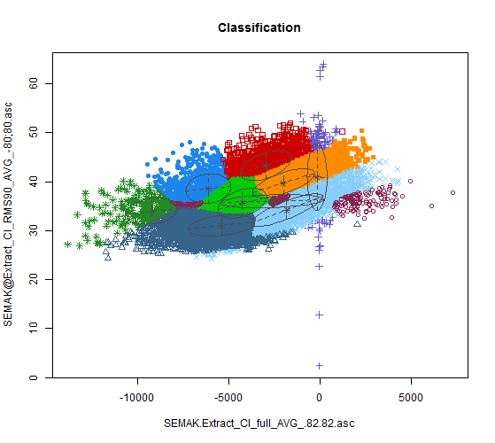
Key difference – PK_r2 + 80ms

Slide 21
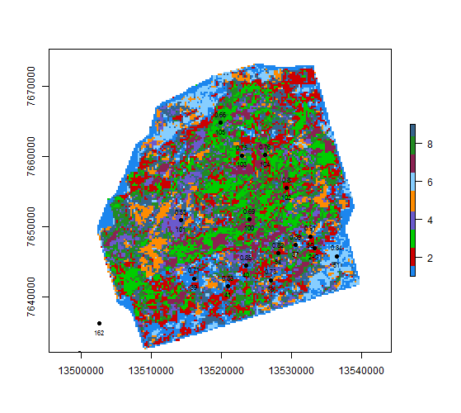
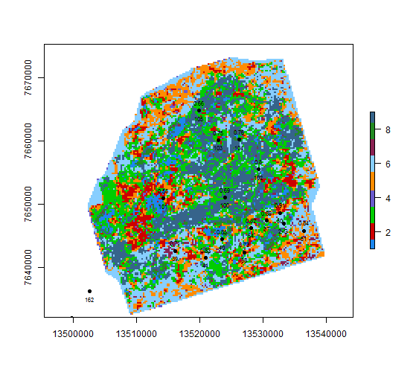
Key difference – PK_r2 + 80ms

Slide 22
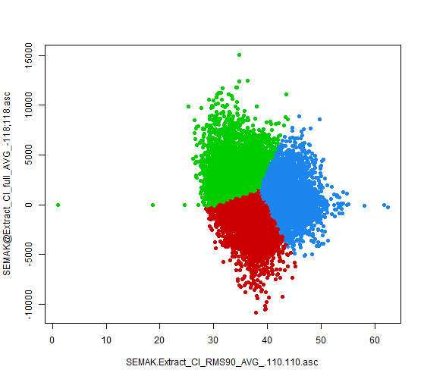
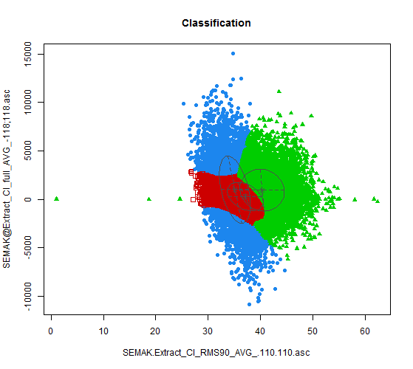
Key difference – PK_r2 + 80ms

Slide 23
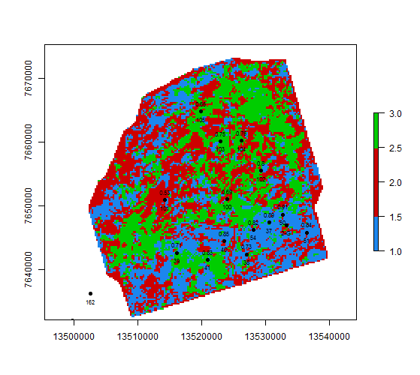
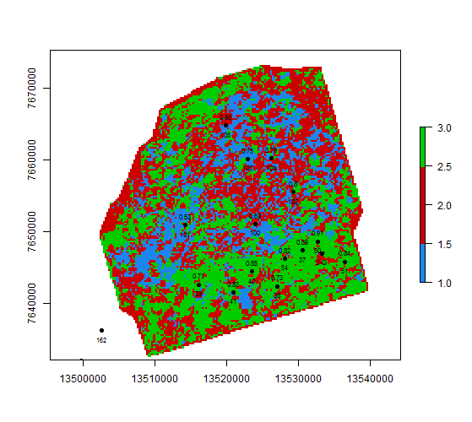
Key difference – PK_r2 + 80ms

Slide 24
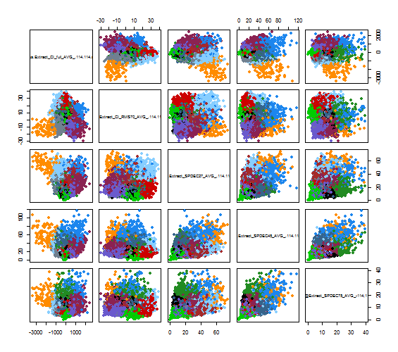
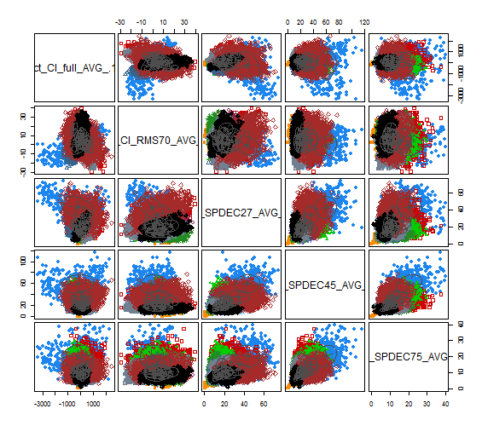

Slide 25
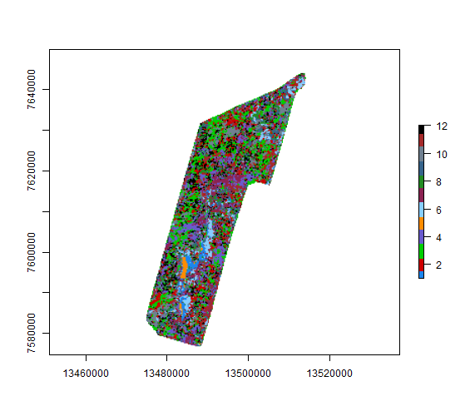
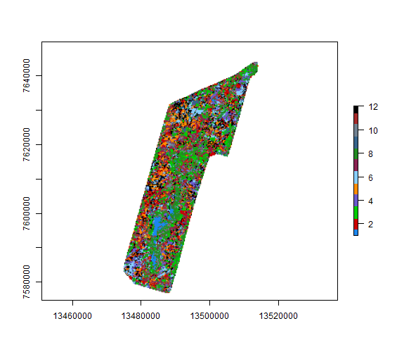

Slide 26
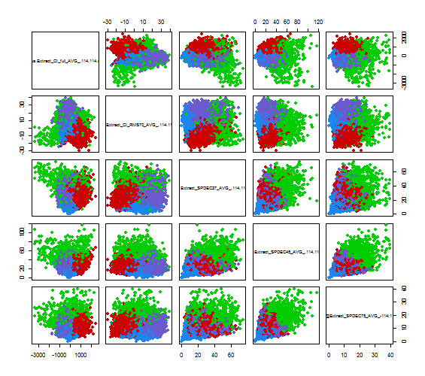
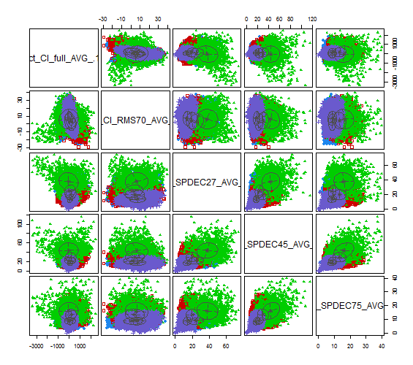

Slide 27



Slide 28



Slide 29



Slide 30


Semak SpDec+CI+CI_RMS C4 + 140ms

Slide 31


Semak SpDec+CI+CI_RMS C4 + 140ms

Slide 32


Semak SpDec+CI+CI_RMS C4 + 110ms

Slide 33


Semak SpDec+CI+CI_RMS C4 + 110ms

Slide 34

Semak SpDec+CI+CI_RMS C4 + 110ms

Slide 35


Semak SpDec+CI+CI_RMS C4 + 110ms

Slide 36



Slide 37



Slide 38


Slide 39



Slide 40



Slide 41

class : RasterLayer
dimensions : 501, 274, 137274 (nrow, ncol, ncell)
resolution : 150, 150 (x, y)
extent : 13473488, 13514588, 7574823, 7649973 (xmin, xmax, ymin, ymax)
coord. ref. : NA
data source : in memory
names : K.means.clustering.with.6.clusters.of.sizes.7464..6364..11942..9366..6345..5536
values : -2748.45, 2858.335 (min, max)
iClasses Values
1 1 NA
2 6 0.2410000
3 5 0.3420000
4 4 0.4548013
5 3 0.5000000
6 2 0.8169381

Slide 42

class : RasterLayer
dimensions : 501, 274, 137274 (nrow, ncol, ncell)
resolution : 150, 150 (x, y)
extent : 13473488, 13514588, 7574823, 7649973 (xmin, xmax, ymin, ymax)
coord. ref. : NA
data source : in memory
names : layer
values : 1, 6 (min, max)
iClasses Values
1 2 NA
2 4 0.3413081
3 6 0.4260000
4 1 0.4550000
5 3 0.5000000
6 5 0.8169381

Slide 43



Slide 44



Slide 45


SVM regression
No smoothing

Slide 46


GLM regression
No smoothing

Slide 47


SVM regression
0.6km smoothing

Slide 48


GLM regression
0.6km smoothing

Slide 49


SVM regression
1.2km smoothing

Slide 50


GLM regression
1.2km smoothing

Slide 51

SVM regression
Kernels QC

Slide 52


Clustering
GMM – averaged in 200x200m

Slide 53


Clustering
KM – averaged in 200x200m

Slide 54


Clustering
HC – averaged in 200x200m

Slide 55


Clustering
SVM one-class – averaged in 200x200m

Slide 56


Regression
SVM – averaged in 200x200m

Slide 57


Regression
GLM – averaged in 200x200m

Slide 58


Regression
NNET – averaged in 200x200m

Slide 59


Regression
NNET – averaged in 200x200m

Slide 60


68 hours : 31 * 16368 = 507408 subsets
SVM models map
GLM models map

Slide 61


68 hours : 31 * 16368 = 507408 subsets
GLM models map (min = 0.7)
GLM models map (min = 0.9)

Slide 62


Slide 63


Slide 64

GLM:
7 maps (127 combinations)
14 x wells
1.5 hours on 4 threads

Slide 65



Multicore performance
61411 subsets (5 maps + 11 wells) on 7/4 threads
GLM
NNET
SVM
GLM: duration = :Time difference of 1.81 mins
NNET: duration = :Time difference of 8.126731 mins
SVM: duration = :Time difference of 9.379603 mins

Slide 66



Multicore performance
2067306 subsets (7 maps + 14 wells) on 6/4 threads
GLM
NNET
SVM
GLM: duration = :Time difference of 1.03533 hours
NNET: duration = :Time difference of 6.64372 hours
SVM: duration = :Time difference of 1.64602 hours

Slide 67

Multicore performance
GLM

